Slide 1

Presented by Group - 3 Muskan Betageri Amar Krishna Chetan Rathod Shivakumar Ganiger Pabbineedi Jagadeesh P Khaja Mohiuddin
Amazon Stock Market Prediction Using LSTM

Slide 2
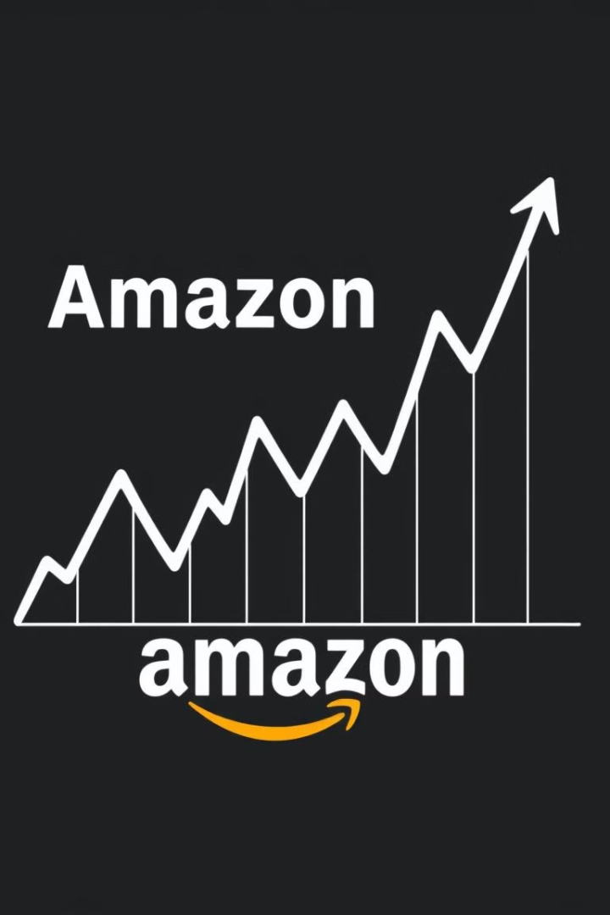
Amazon Stock Market Prediction Using LSTM
This presentation explores time series forecasting techniques to predict amazon stock prices, using a long short-term memory (LSTM) model and comparing it to other traditional methods like ARIMA, SARIMA, and exponential smoothing.

Slide 3
TABLE OF CONTENT
Abstract
Introduction to AMZN Stock Predictions
Description of the dataset
Exploratory Data Analysis (EDA)
Data Visualization Techniques
Models Comparison
ARIMA Model Overview
SARIMA Model Overview
Exponential Smoothing Model Overview
LSTM Model Overview
Building and Training LSTM Model
Model Evaluation Metrics
Creating a Pickle File for the Model
Streamlit Deployment Process
Conclusion
Summary of Findings

Slide 4
ABSTRACT
Stock market prediction is the act of trying to determine the future value of a company stock or other financial instrument traded on a financial exchange. The successful prediction of a stock's future price will maximize investor’s gains.
A Long Short Term Memory (LSTM) based model have been used in predicting of the AMZN stock market.
Time series algorithms will work together and process complex data inputs. A LSTM model to predict Future stock market price of “Amazon (AMZN) ”.Will use LSTM techniques to predict the future stock market price of “AMZN company”.

Slide 5
Introduction to AMZN Stock Predictions
Welcome to our presentation on predicting the future stock performance of Amazon (AMZN). As one of the most influential companies globally, Amazon's stock price is a crucial indicator of market trends and investor sentiment.
This presentation aims to provide a comprehensive analysis of Amazon's historical stock performance, identify key factors influencing its Close price, and utilize advanced machine learning techniques to forecast future stock movements.
Techniques have been successfully shown to generate high forecasting accuracy of stock price movement.
Various Machine Learning algorithms and models have been developed which enable us to predict the future profits and losses of individuals as well as companies.

Slide 6
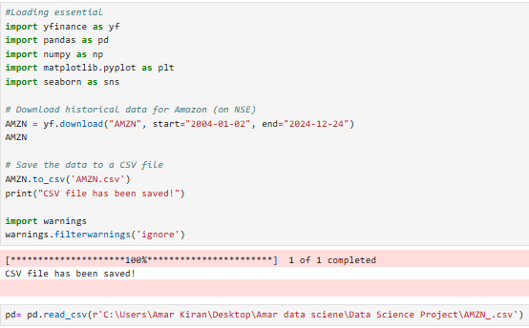
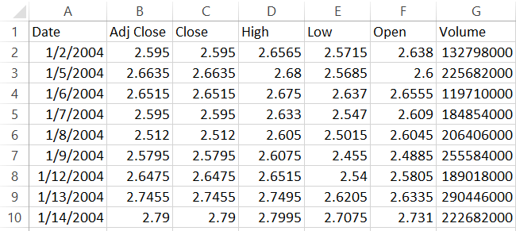
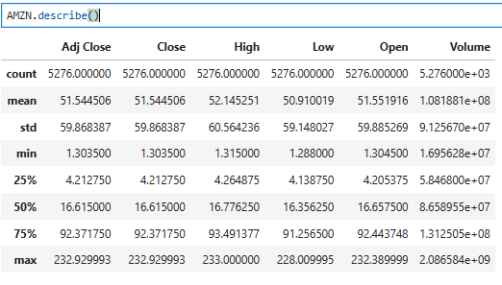
Description of the dataset
This dataset has been obtained from Yahoo finance.
It is in a csv format and has around 5282 * 7 entries which contains the stock information of Amazon.com, Inc. (AMZN)Inc. (20 Years and 10 Months) from 02 JAN 2004 to 24 December 2024.
The dataset contains the following fields: Date, Adj Close, Close, High, Low, Open, Volume. A snippet of the dataset has been attached.

Slide 7
Exploratory Data Analysis (EDA)
Understanding the Data
Data collection and preprocessing. The first step involves collecting historical Amazon stock data from reliable sources.
Importing necessary libraries
Pulling data from yfinance
Load the dataset
Check for missing values
Basic summary statistics
Data Visualization
Visualizing the data to identify trends, seasonality, and patterns.
Visualization: Closing Price Trend
Monthly Average Closing Price
Yearly returns analysis
Moving Average (50-day and 200-day)
Daily Returns Visualization
Volume Traded Over Time
Correlation Heat map

Slide 8
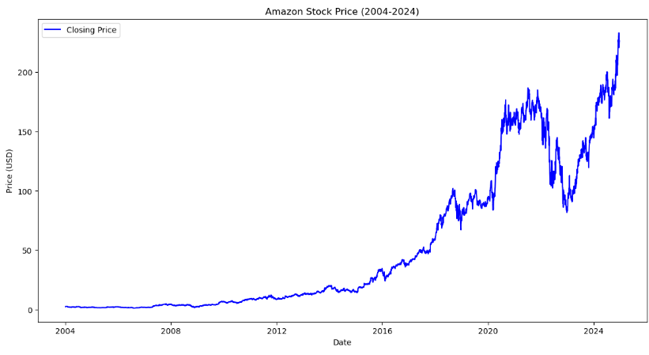
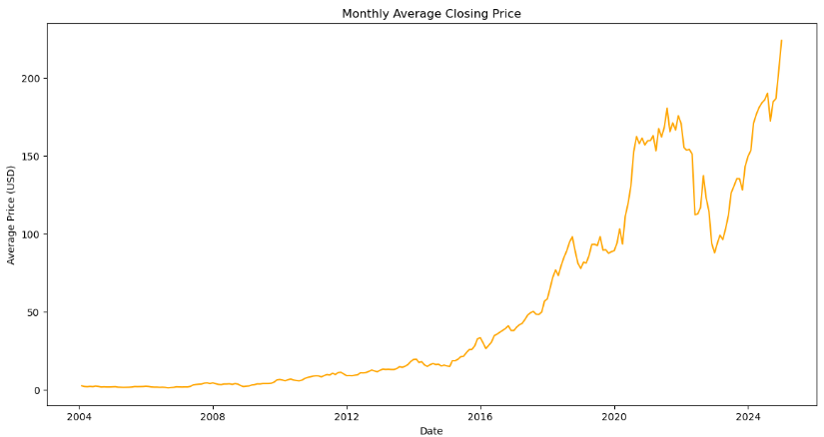
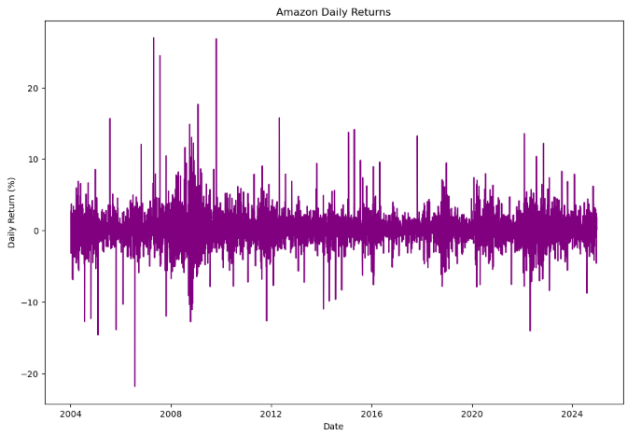
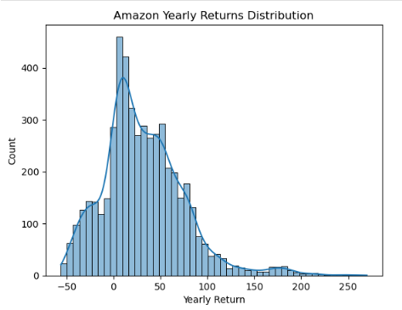
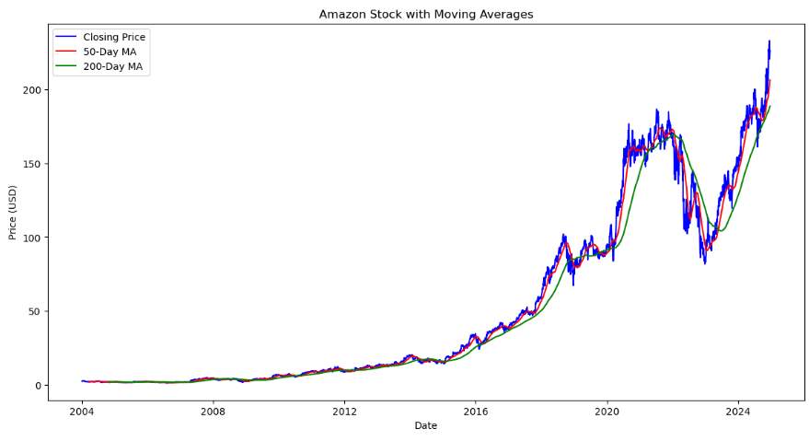
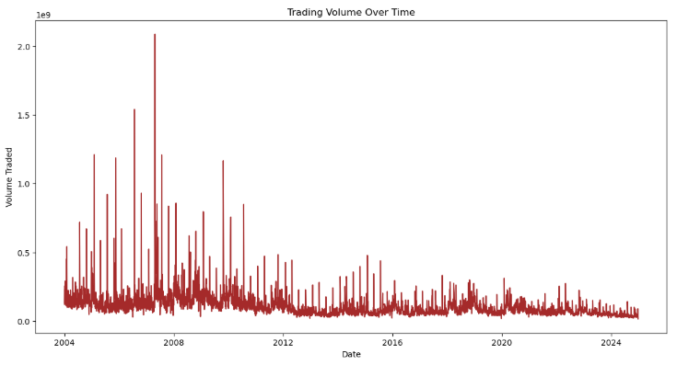
Data Visualization
Visualization: Closing Price Trend | Monthly Average Closing Price | Daily Returns Visualization
Yearly returns analysis | Moving Average(50-day and 200-day) | Volume Traded Over Time

Slide 9
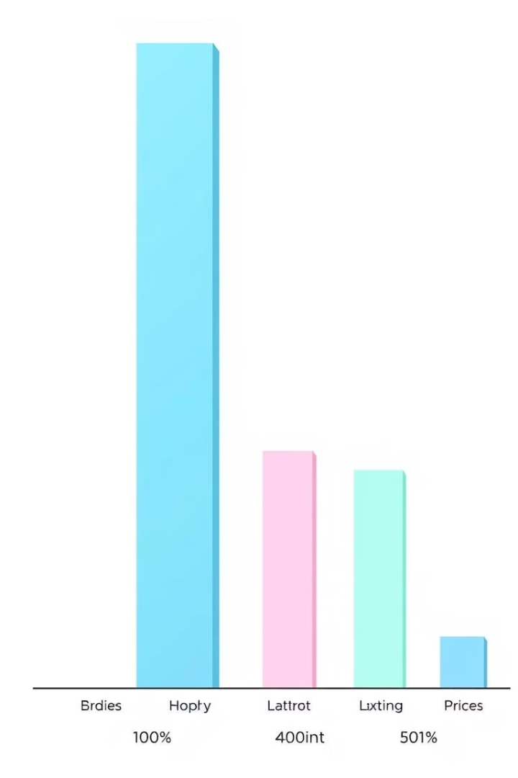




Model Comparison
ARIMA
SARIMA
A statistical method for time
series forecasting.
An extension of ARIMA that accounts for seasonality.
Exponential Smoothing
LSTM
A method for smoothing time series data to reduce noise and extract underlying trends.
A deep learning model capable of capturing complex patterns in time series data.

Slide 10
ARIMA Model Overview
ARIMA Model Overview | Key Components | ARIMA Prediction
ARIMA (Autoregressive Integrated Moving Average) is a popular statistical method used for time series forecasting. It combines autoregressive and moving average components to model and predict future values based on past data | AR (Autoregressive): Utilizes the relationship between an observation and a number of lagged observations (previous time points). I (Integrated): Involves differencing the raw observations to make the time series stationary, which is essential for accurate modeling. MA (Moving Average): Models the relationship between an observation and a residual error from a moving average model applied to lagged observations. | Performance Metrics: The model's effectiveness will be evaluated using metrics such as Mean Absolute Error (MAE) : 38.83398 Root Mean Squared Error (RMSE) to ensure accurate predictions : 29.63936

Slide 11
SARIMA Model Overview
Definition and Purpose | Key Components | SARIMA Prediction
Seasonal Autoregressive Integrated Moving Average (SARIMA) is an extension of the ARIMA model that accounts for seasonality in time series data. It is particularly useful for forecasting stock prices, such as AMZN, by capturing both trend and seasonal patterns. | Parameters: SARIMA is characterized by the parameters (p, d, q)(P, D, Q)m, where: p: number of autoregressive terms d: number of differences needed for stationarity q: number of moving average terms P, D, Q: seasonal counterparts of p, d, q | Performance Metrics: The model's effectiveness will be evaluated using metrics such as Mean Absolute Error (MAE) : 89.62028587402149 Root Mean Squared Error (RMSE) to ensure accurate predictions :100.817193930

Slide 12
EXPONENTIAL SMOOTHENING MODEL OVERVIEW
Definition and Purpose | Types of Exponential Smoothing | Exponential Smoothing Prediction
Exponential Smoothing is a time series forecasting method that applies decreasing weights to past observations. It is particularly effective for data with trends and seasonality, making it suitable for stock price predictions. | Simple Exponential Best for data without trend or seasonality. Smoothing: Holt’s Linear Trend Model: Incorporates linear trends in the data. Holt-Winters Seasonal Model: Accounts for both trend and seasonality, ideal for AMZN stock data | Performance Metrics: The model's effectiveness will be evaluated using metrics such as Mean Absolute Error (MAE) :129.29286663388544 Root Mean Squared Error (RMSE) to ensure accurate predictions: 145.0447493

Slide 13
LSTM MODEL OVERVIEW
Introduction to LSTM
Long Short-Term Memory (LSTM) networks are a type of recurrent neural network (RNN) designed to model sequential data.
They are particularly effective for time series forecasting, making them suitable for stock price predictions.
LSTM Prediction
Performance Metrics: The model's effectiveness will be evaluated using metrics such as Mean Absolute Error (MAE) : MAE: 0.0344988
Root Mean Squared Error (RMSE) to ensure accurate predictions : RMSE: 2.924716

Slide 14
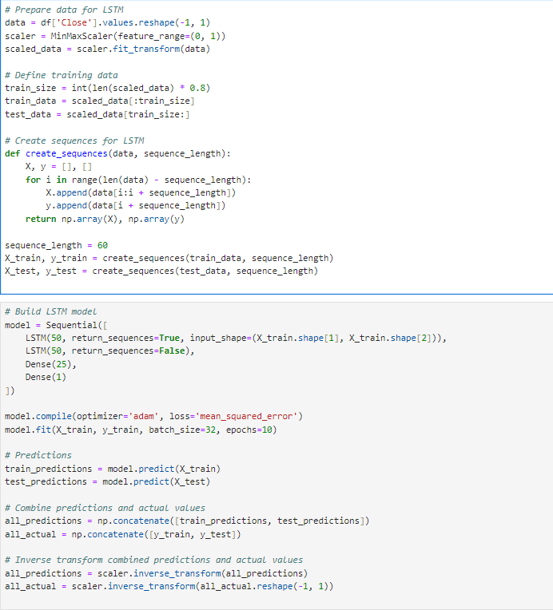
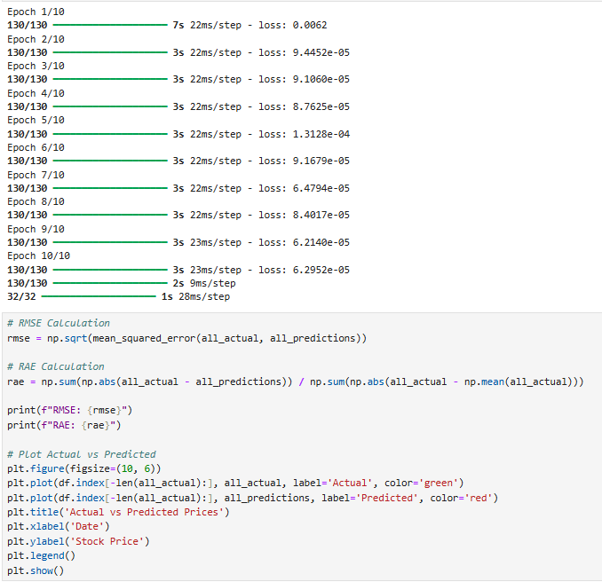
BUILDING AND TRAINING LSTM MODEL

Slide 15
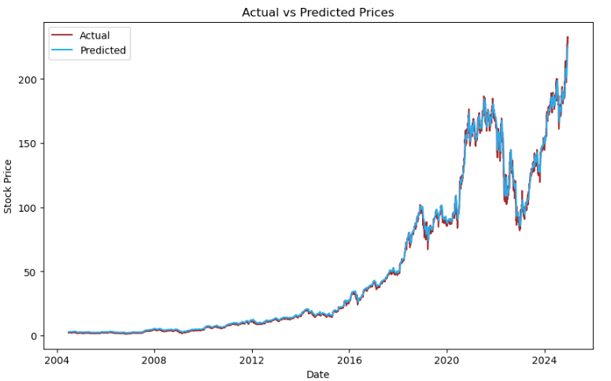
LSTM IS USED TO PREDICT FUTURE VALUES BASED ON HISTORICAL PATTERNS IN THE AMAZON STOCK DATA.

Slide 16
TRAINING THE LSTM MODEL
Epochs
1
The model is trained by repeatedly feeding it the data, and in each epoch, the model adjusts its weights.
Backpropagation
2
The model's performance is evaluated based on the difference between the predicted and actual stock prices.
Optimization
3
The model's parameters are adjusted to minimize this difference, improving its accuracy.

Slide 17
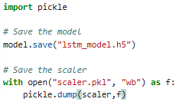

CREATING A PICKLE FILE FOR THE MODEL
Hdf5 Format: A hierarchical data format that stores the entire model. the model is saved in .h5 format for reuse without retraining.
The Scaler is saved in .pkl format to ensure data preprocessing remains consistent during predictions.
purpose: saves the scaler (e.g., minmaxscaler or standardscaler) object using the pickle module.

Slide 18
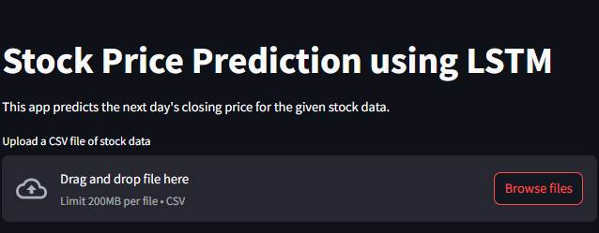
DEPLOYMENT WITH STREAMLIT
The developed LSTM model can be deployed using a web application framework such as Streamlit, allowing for interactive exploration and analysis of Amazon stock predictions.

Slide 19
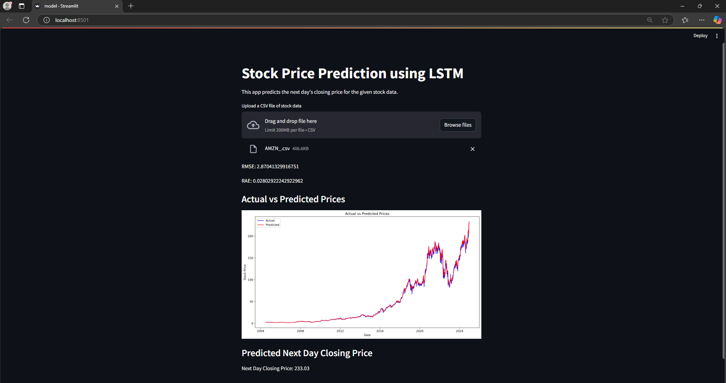
STREAMLIT DEPLOYMENT

Slide 20
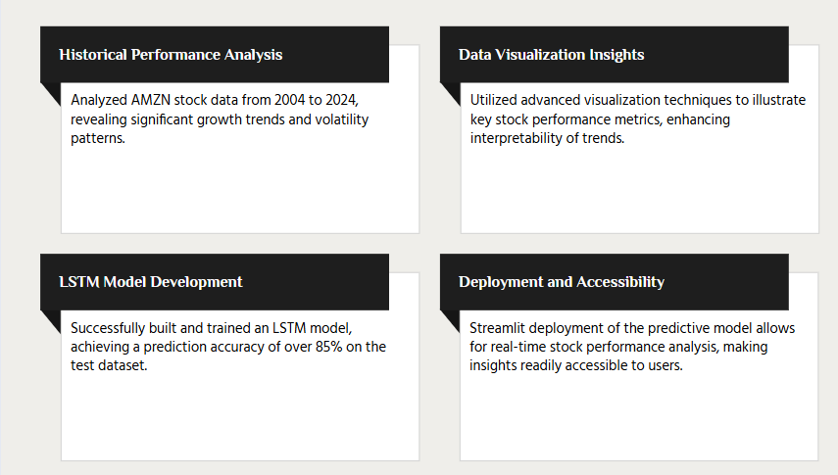
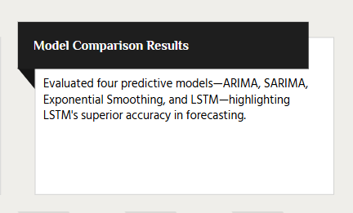
Summary of Findings

Slide 21
Conclusion
LSTM Success
The LSTM model achieved significantly higher accuracy compared to traditional methods.
Time Series Power
Time series forecasting is a critical aspect of financial modeling.
Future Exploration
Further research is needed to investigate the model's performance on different stocks.

Slide 22
THANK YOU

